Slide 1
prescriptive analytics
Ali Youssef Ali
18101591

Slide 2
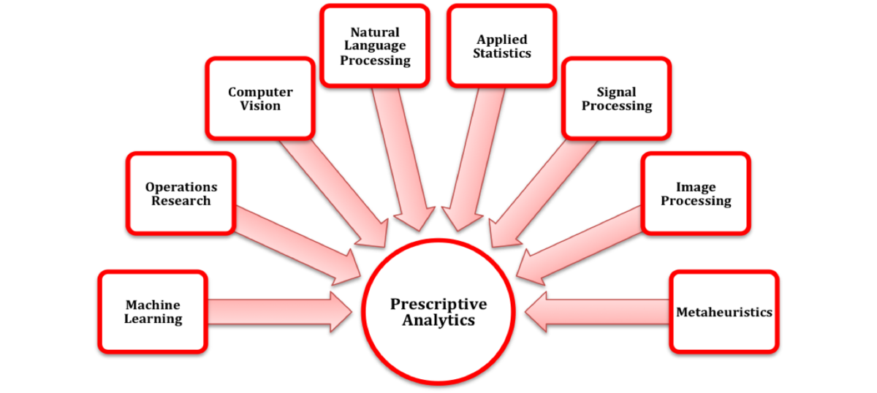

Slide 3
What is prescriptive analytics
Prescriptive analytics is the process of using data to determine an optimal course of action. By considering all relevant factors, this type of analysis yields recommendations for next steps. Because of this, prescriptive analytics is a valuable tool for data-driven decision-making.

Slide 4
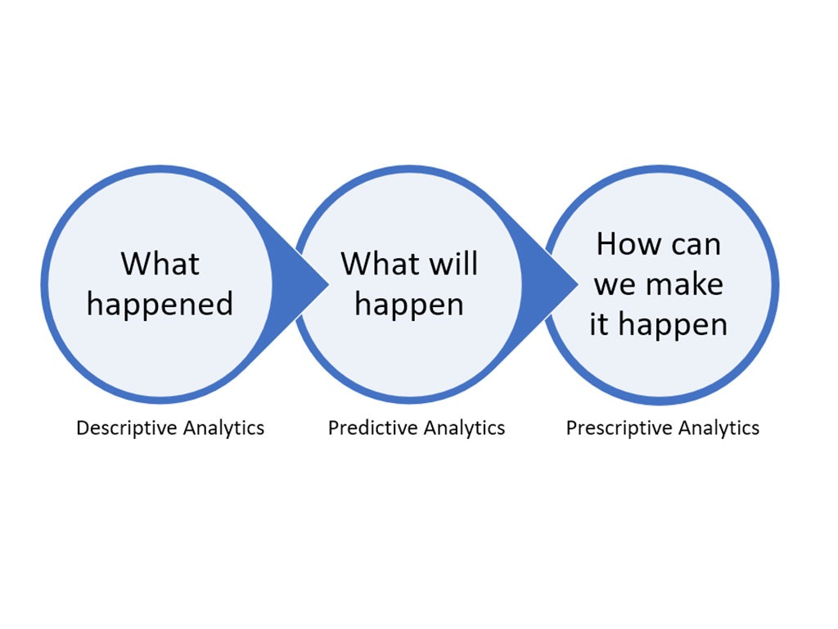

Slide 5
How Prescriptive Analytics Works
Prescriptive analytics relies on artificial intelligence techniques, such as machine learning—the ability of a computer program, without additional human input, to understand and advance from the data it acquires, adapting all the while. Machine learning makes it possible to process a tremendous amount of data available today. As new or additional data becomes available

Slide 6
The Pros and Cons of Prescriptive Analytics
Prescriptive analytics can cut through the clutter of immediate uncertainty and changing conditions. It can help prevent fraud, limit risk, increase efficiency, meet business goals, and create more loyal customers.
Prescriptive analytics is not foolproof, however. It is only effective if organizations know what questions to ask and how to react to the answers. If the input assumptions are invalid, the output results will not be accurate.

Slide 7
Examples of Prescriptive Analytics
Prescriptive analytics could be used to evaluate whether a local fire department should require residents to evacuate a particular area when a wildfire is burning nearby. It could also be used to predict whether an article on a particular topic will be popular with readers based on data about searches and social shares for related topics.

Slide 8
Benefits of prescriptive analytics
Effortlessly map the path to success. Prescriptive analytic models are designed to pull together data and operations to produce the roadmap that tells you what to do and how to do it right the first time. Artificial intelligence takes the reins of business intelligence to apply simulated actions to a scenario to produce the steps necessary to avoid failure or achieve success.

Slide 9
Benefits of prescriptive analytics
Inform real-time and long-term business operations. Decision makers can view both real-time and forecasted data simultaneously to make decisions that support sustained growth and success. This streamlines decision making by offering specific recommendations.

Slide 10
Benefits of prescriptive analytics
Spend less time thinking and more time doing. The instant turnaround of data analysis and outcome prediction lets your team spend less time finding problems and more time designing the perfect solutions. Artificial intelligence can curate and process data better than your team of data engineers and in a fraction of the time.

Slide 11
Benefits of prescriptive analytics
Reduce human error or bias. Through more advanced algorithms and machine learning processes, predictive analytics provides an even more comprehensive and accurate form of data aggregation and analysis than descriptive analytics, predictive analytics, or even individuals.

Slide 12
References
https://www.investopedia.com/terms/p/prescriptive-analytics.asp
https://www.talend.com/resources/what-is-prescriptive-analytics/

